Slide 1


Welding Defection Inspection A Project by Infinity 6 for AST

Slide 2
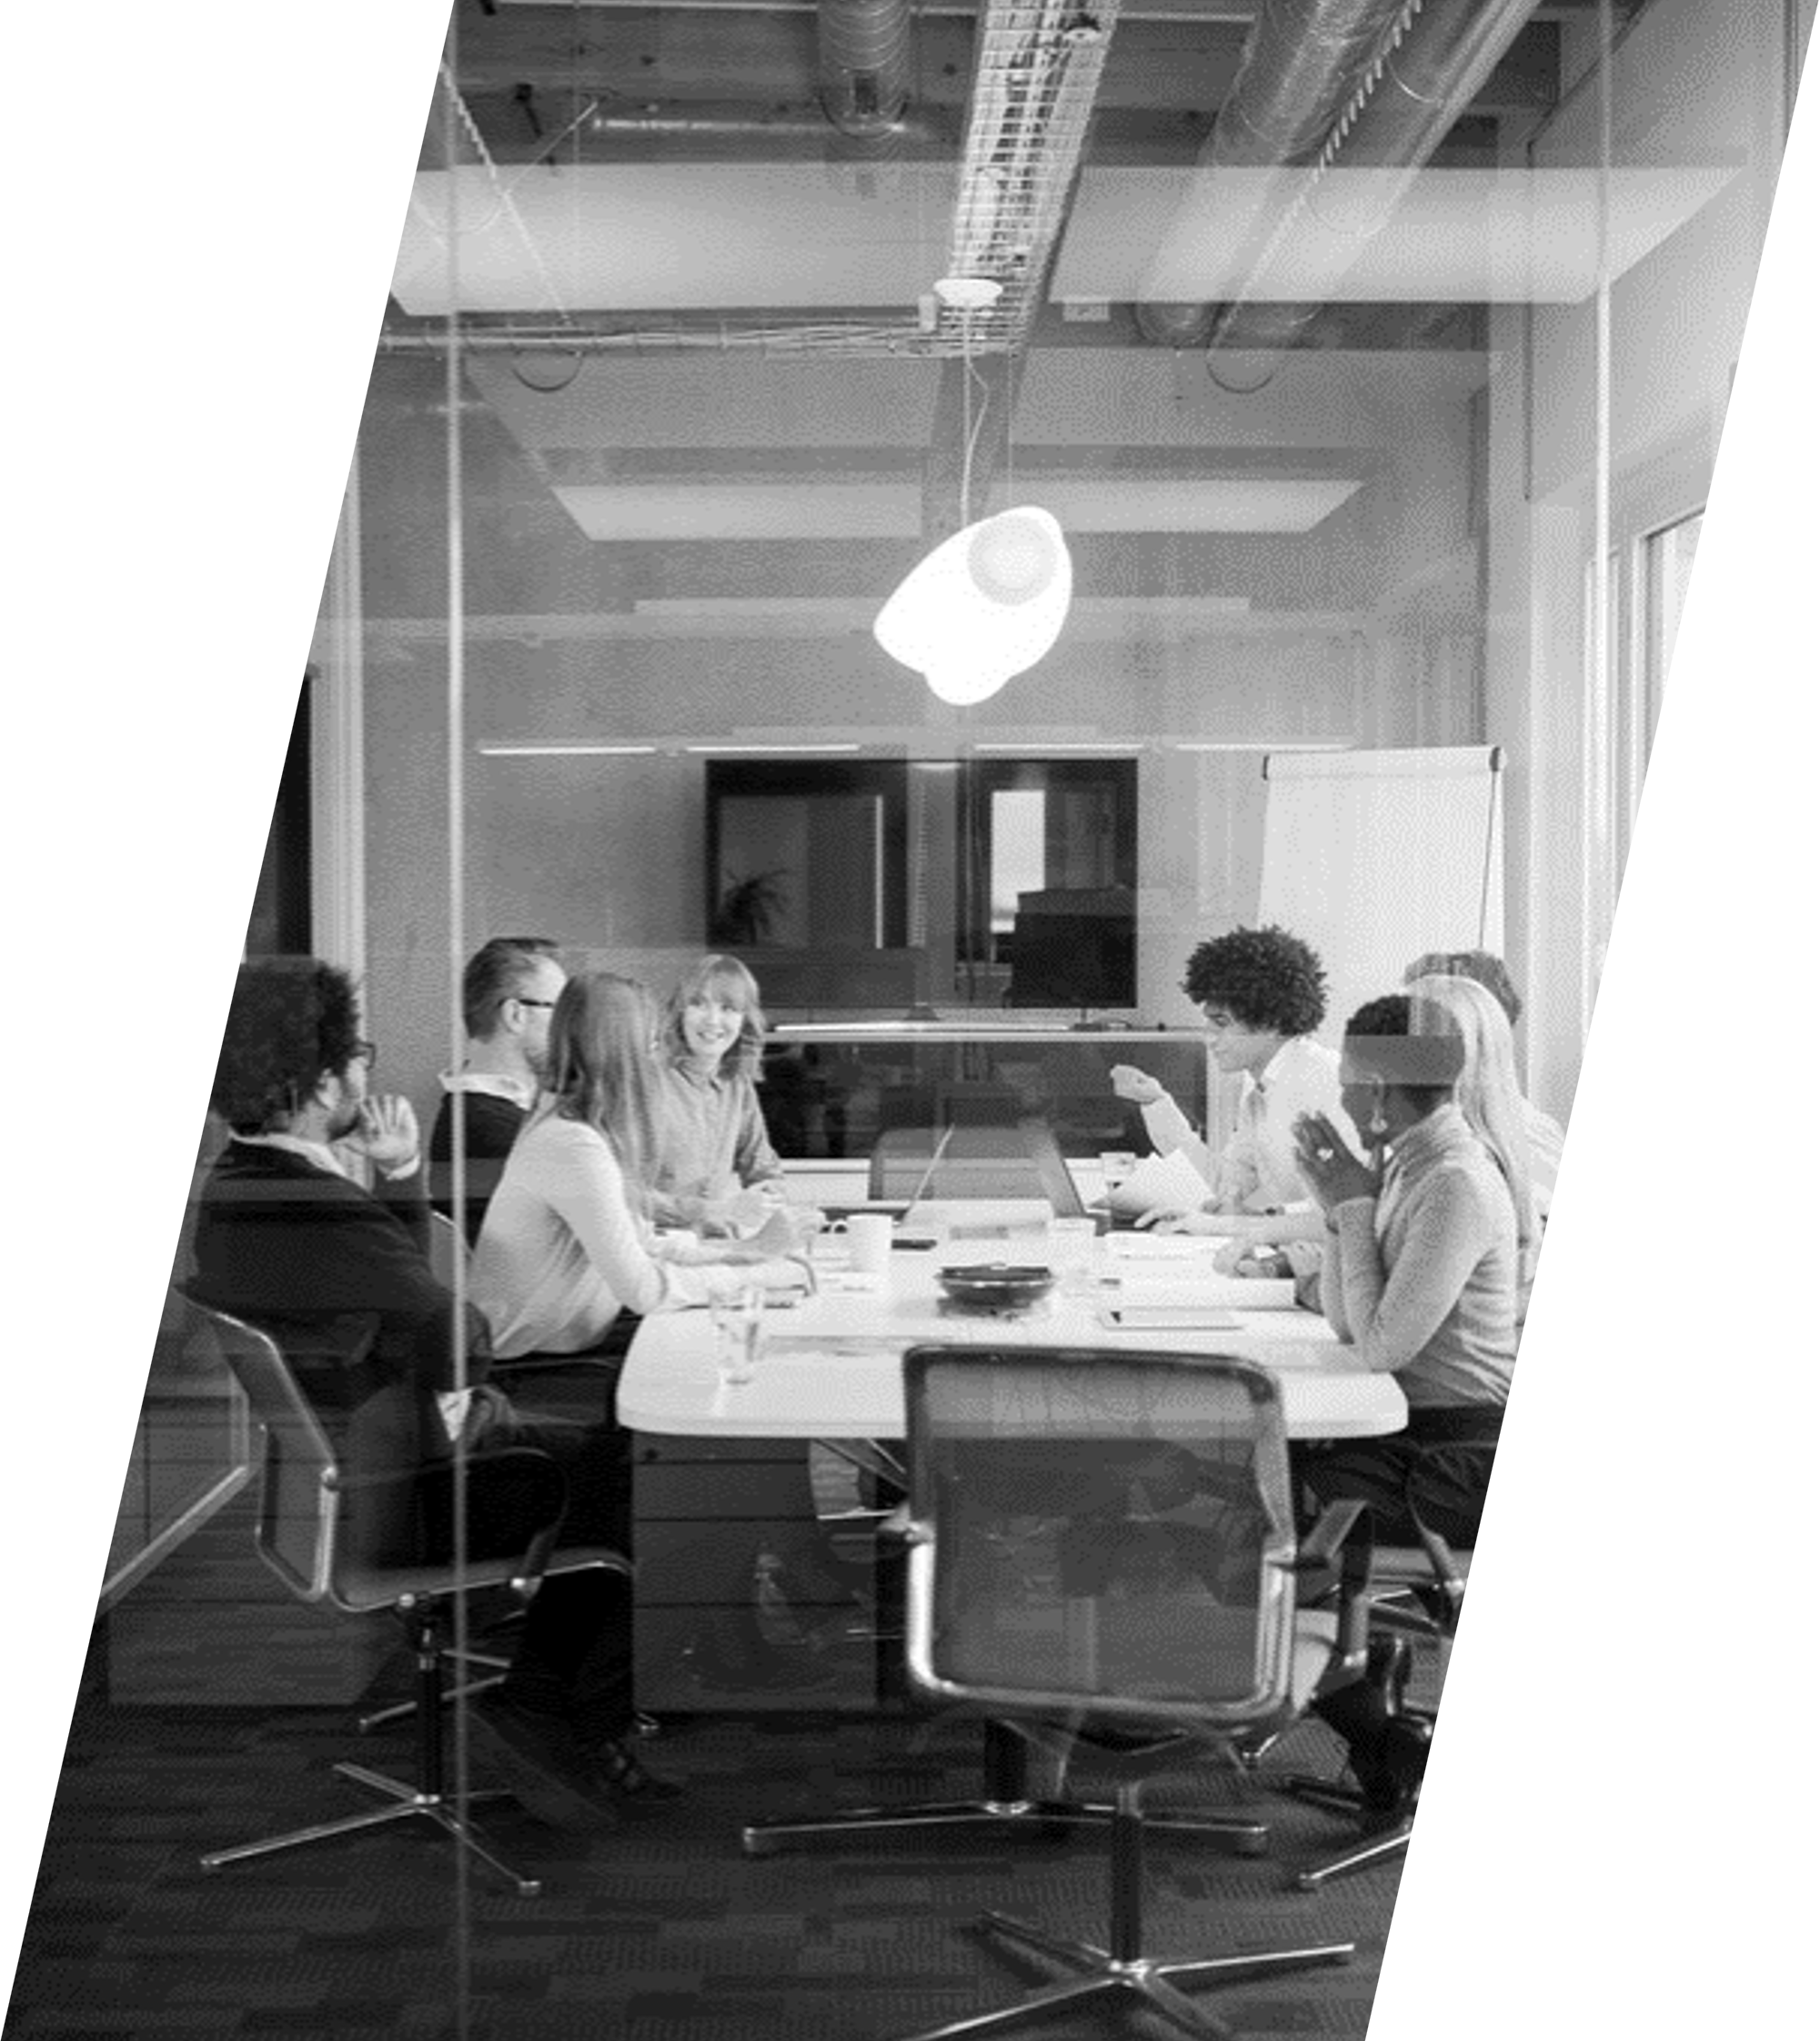
INTRODUCTION
Brief overview of the project Team
name: Infinity 6
COMPANY: AST

Slide 3
Team Members
Kareem Badr Saber
Walid Mohammed Mustafa
Mohamed Al-Wakeel
Ziad Ashraf Abdel Malek
Youssef Salah El-Din Mustafa
Abdul Rahman Mohammed Hassan

Slide 4
Project Overview
Explanation of the project "Welding Defection Inspection:
The "Welding Defection Inspection" project involves the use of artificial intelligence (AI) to inspect welds and determine their quality based on visual data. The system is designed to take pictures of welds (presumably from various sources such as factories, industrial settings, or nature), and analyze whether the weld is good or defective
Objective
The goal is to automate the process of weld quality inspection. This helps reduce human error, speed up inspections, and ensure the safety and reliability of welded structures, especially in critical industries like aerospace, automotive, and construction

Slide 5
Project Overview
Task 1: Data Collection
Responsible Members: Kareem Badr Saber & Walid Mohammed Mustafa
Description: Collecting images of welding from different environments for analysis.
Task 2: Pre-Data Processing
Responsible Members: Ziad Ashraf & Mohamed Al-Wakeel
Description: Processing the collected data to ensure it is ready for AI analysis.
Task 3: Training Data
Responsible Members :Youssef Salah El-Din Mustafa& Abdul Rahman Mohammed Hassan
Description: Training AI models using the processed data to detect welding defects.

Slide 6

THANK YOU

